Slide 1
RGB-D Recognition: A Feature Learning Approach
Xiaofeng Ren
Corporate Project, Amazon
Work done @ Intel and U Washington with Liefeng Bo, Kevin Lai, Dieter Fox
Tutorial @ CVPR 2014

Slide 2
Real-time RGB-D Sensor Data
Opportunities: robust real-time recognition will have far-reaching impacts
Challenges: how to effectively make use of RGB-D data for recognition
Intel Seattle lab , circa 2010

Slide 3
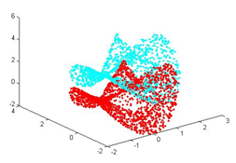
Standard Approaches to 3D Recognition
Point Cloud Matching
Iterative Closest Point (ICP) and variants
[Besl 92; Rusinkiewicz 01]
3D Shape Descriptors
Spin Images [Johnson 99]
Spherical Harmonics Shape Descriptors [Vranic 01; Kazhdan 03]
Fast Point Feature Histograms [Rusu 08,09]
Heat Kernel Signatures [Sun 09; Borenstein 11]
Challenges for Existing Point Cloud-based Techniques
How to handle intra-class shape variations in category recognition?
How to handle partial shapes, in particular from a single viewpoint?
How to work with training data of partial shapes, without having to construct a single, complete 3D model?
Notes:
To use the overloaded term context awareness,

Slide 4
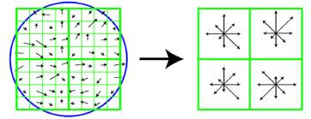
Standard Approaches to RGB Recognition
Feature Matching for Instance Recognition
SIFT [Lowe 04] + RANSAC + Bag-of-Words
Dense Features and Pooling for Category Recognition
Dense local features: SIFT, HOG, KDES, …
Nonlinear coding: Bag-of-Words, Sparse Coding, Neural Network, …
Spatial Pyramid Pooling + SVM
Deep Learning
Challenges for Existing Image Classification Techniques
How to design or learn RGB-D local features?
How to integrate information from multiple frames/viewpoints?
How to utilize RGB-D data better than simply adding RGB and D?
Notes:
To use the overloaded term context awareness,

Slide 5
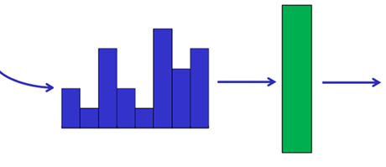
A Typical Recognition Pipeline
Bag-of-Words
Sparse Coding
Your favorite model
SIFT (or HOG)
Spatial Pyramid Matching (SPM)
Efficient Match Kernel (EMK)
Recognition
Objects Patch features Object features
Notes:
Mention deep belief networks.
That’s why deep belief networks are so interesting.
Inverted pyramid
Of course, there exist works on 3d features such as spin images. But they typically operate on full 3D meshes, not a depth image which is a single view of a 3D structure.
For the next 8 minutes or so,
A typical pipeline of recognition goes like this:
SIFT, the Scale Invariance Feature Transform from David Lowe, a very popular and dominant visual feature.
Feed into classifiers like a SVM.
We can ask the question, how can we develop features on RGB-D images that are the equivalent, or the better of SIFT?
This is the essence of image features. It is a very natural formulation to measure similarities between patches, and it includes SIFT as a special case.
Moreover, by having this general form,

Slide 6
Need for RGB-D Features
Bag-of-Words
Sparse Coding
?
Your favorite model
SIFT (or HOG)
Spatial Pyramid Matching (SPM)
Efficient Match Kernel (EMK)
Recognition
Objects Patch features Object features
Notes:
Mention deep belief networks.
That’s why deep belief networks are so interesting.
Inverted pyramid
Of course, there exist works on 3d features such as spin images. But they typically operate on full 3D meshes, not a depth image which is a single view of a 3D structure.
For the next 8 minutes or so,
A typical pipeline of recognition goes like this:
SIFT, the Scale Invariance Feature Transform from David Lowe, a very popular and dominant visual feature.
Feed into classifiers like a SVM.
We can ask the question, how can we develop features on RGB-D images that are the equivalent, or the better of SIFT?
This is the essence of image features. It is a very natural formulation to measure similarities between patches, and it includes SIFT as a special case.
Moreover, by having this general form,

Slide 7
Outline of Presentation
Introduction
RGB-D Features for Object Recognition
Benchmark and Baseline
Kernel Descriptors: Generalizing SIFT
Hierarchical Matching Pursuit: Unsupervised Feature Learning
Related Works and Applications
Toward Understanding Real-World Scenes
Hierarchical Matching Pursuit and Object Detection
RGB-D Boundary Detection
RGB-D Features for Scene Labeling

Slide 8
Outline of Presentation
Introduction
RGB-D Features for Object Recognition
Benchmark and Baseline
Kernel Descriptors: Generalizing SIFT
Hierarchical Matching Pursuit: Unsupervised Feature Learning
Related Works and Applications
Toward Understanding Real-World Scenes
Hierarchical Matching Pursuit and Object Detection
RGB-D Boundary Detection
RGB-D Features for Scene Labeling

Slide 9
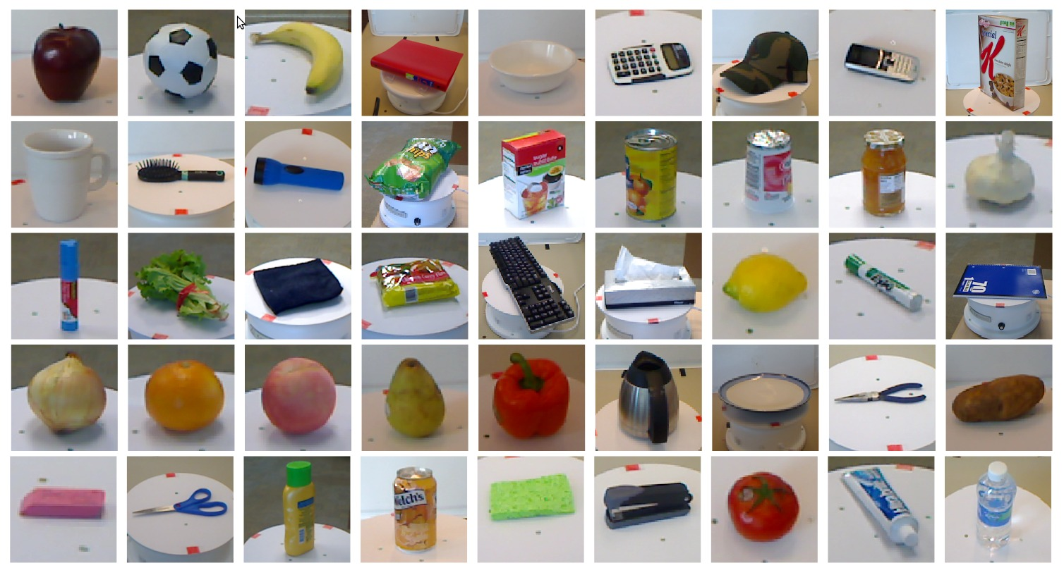
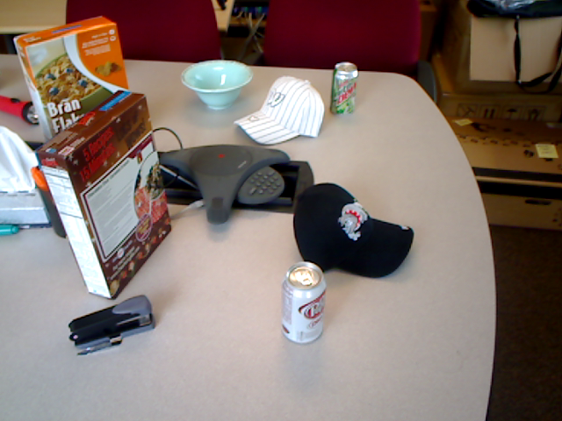
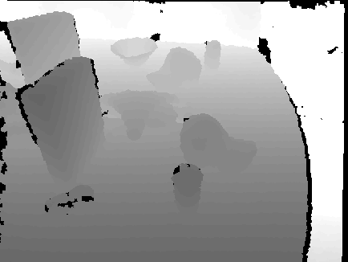
RGB-D Recognition: Benchmark
303 objects from 51 categories, 250,000 RGB-D views
http://www.cs.washington.edu/rgbd-dataset/
Cluttered scenes
A standard benchmark for RGB-D recognition of everyday objects
(both category recognition and instance recognition)
[Lai, Bo, Ren, Fox; ICRA 2011]

Slide 10
RGB-D Recognition: Baseline
303 objects from 51 categories, 250,000 RGB-D views
http://www.cs.washington.edu/rgbd-dataset/
Cluttered scenes
A standard benchmark for RGB-D recognition of everyday objects
[Lai, Bo, Ren, Fox; ICRA 2011]

Slide 11
How to Obtain RGB-D Features?
Designed
Learned
SIFT
Deep Network
Kernel Descriptors
Sparse Codes
Faster, more specialized
More generic, adaptive

Slide 12
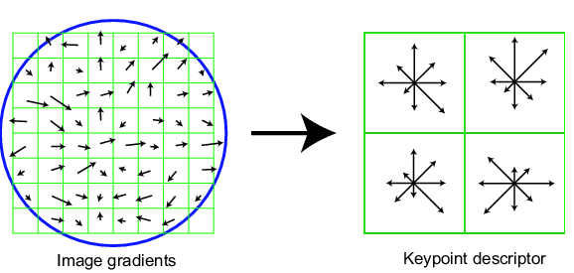
SIFT: Histogram of Gradient Orientations
Dominant gradient orientation at each pixel
Weighted by gradient magnitude
Aggregated over 4x4 subpatches (2x2 shown)
8 orientations x 4 x 4 = 128 dimensions
[Lowe; IJCV 2004]
Notes:
A typical pipeline of recognition goes like this:
SIFT, the Scale Invariance Feature Transform from David Lowe, a very popular and dominant visual feature.
Feed into classifiers like a SVM.
We can ask the question, how can we develop features on RGB-D images that are the equivalent, or the better of SIFT?
This is the essence of image features. It is a very natural formulation to measure similarities between patches, and it includes SIFT as a special case.
Moreover, by having this general form,

Slide 13
SIFT as Gradient Match Kernel
SIFT descriptor on a patch ➔ similarity between a pair of patches
Linear kernel on histograms = a sum over all pairs of pixels
$$F\left(P\right)=\sum_{u∈P}{m_{u}θ\left(u\right)x\left(u\right)}$$
$$F\left(Q\right)=\sum_{v∈Q}{m_{v}θ\left(v\right)x\left(v\right)}$$
$$F\left(P\right)∙F\left(Q\right)=\left(\sum_{u∈P}{m_{u}θ\left(u\right)x\left(u\right)}\right)\left(\sum_{v∈Q}{m_{v}θ\left(v\right)x\left(v\right)} \right)$$
indicator functions for histogram binning
$$=\sum_{u∈P}{\sum_{v∈Q}{m_{u}m_{v}\left[θ\left(u\right)θ\left(v\right)\right][x\left(u\right)x\left(v\right)}]}$$
0 or 1 for histograms, at pixel level
[Bo, Ren, Fox; NIPS 2010]
Notes:
A typical pipeline of recognition goes like this:
SIFT, the Scale Invariance Feature Transform from David Lowe, a very popular and dominant visual feature.
Feed into classifiers like a SVM.
We can ask the question, how can we develop features on RGB-D images that are the equivalent, or the better of SIFT?
This is the essence of image features. It is a very natural formulation to measure similarities between patches, and it includes SIFT as a special case.
Moreover, by having this general form,

Slide 14
SIFT as Gradient Match Kernel
Linear kernel on SIFT descriptors
= a product of two histograms
= a product summed over all pairs of pixels
gradient
orientation
relative
position
gradient magnitude
Gradient
Match Kernel
image patch
pixel kernels
Includes SIFT as a special case
Avoids any “binning” issues in histogram features
[Bo, Ren, Fox; NIPS 2010]
Notes:
A typical pipeline of recognition goes like this:
SIFT, the Scale Invariance Feature Transform from David Lowe, a very popular and dominant visual feature.
Feed into classifiers like a SVM.
We can ask the question, how can we develop features on RGB-D images that are the equivalent, or the better of SIFT?
This is the essence of image features. It is a very natural formulation to measure similarities between patches, and it includes SIFT as a special case.
Moreover, by having this general form,

Slide 15
Approximating Gradient Match Kernel
Gradient
Match Kernel
$${{Find F_{grad} s.t. K}_{grad}(P,Q)≈F}_{grad}\left(P\right)∙F_{grad}(Q)$$
$$k_{o}\left(θ_{u},θ_{v}\right)=φ_{o}\left(θ_{u}\right)⋅φ_{o}\left(θ_{v}\right)$$
$$k_{p}\left(u,v\right)=φ_{p}\left(u\right)⋅φ_{p}\left(v\right)$$
very low dimensional attributes (dimθ=1,dimx=2)
➔ can densely sample θ and x; hence infinite➔finite
[Bo, Ren, Fox; NIPS 2010]
Notes:
Mercer’s theorem

Slide 16
Approximating Gradient Match Kernel
Gradient
Match Kernel
tensor product
m bases {ф_{o}(θ_{i})} and n bases {ф_{p}(x_{j})}
➔ mn bases {ф_{o}(θ_{i})⊗ф_{p}(x_{j})}
can be approximated to mn dimensions.
100x50=5000
[Bo, Ren, Fox; NIPS 2010]

Slide 17
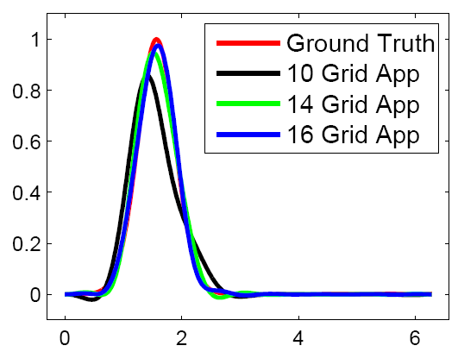
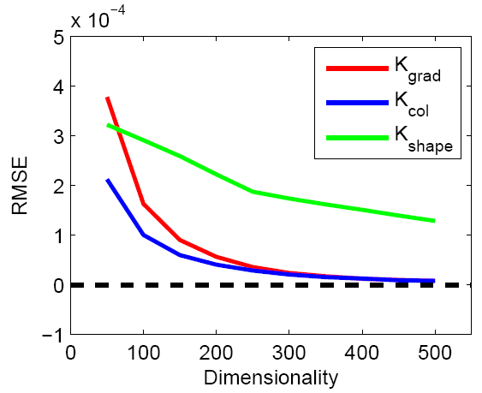
Dimension Reduction with kPCA
From a set of sampled bases {ф_{o}(θ_{i})⊗ф_{p}(x_{j})}, run kernel PCA.
Let the t^{th} kernel principal component be
The t^{th} component of the gradient kernel descriptor is
Orientation samples
kPCA dimension
[Bo, Ren, Fox; NIPS 2010]
Notes:
A typical pipeline of recognition goes like this:
SIFT, the Scale Invariance Feature Transform from David Lowe, a very popular and dominant visual feature.
Feed into classifiers like a SVM.
We can ask the question, how can we develop features on RGB-D images that are the equivalent, or the better of SIFT?
This is the essence of image features. It is a very natural formulation to measure similarities between patches, and it includes SIFT as a special case.
Moreover, by having this general form,

Slide 18
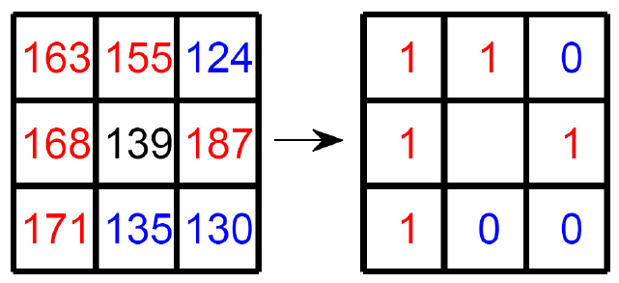
Shape and Color Kernel Descriptors
local binary patterns
pixel RGB values
A color descriptor that preserves spatial information
[Bo, Ren, Fox; NIPS 2010]
Notes:
A typical pipeline of recognition goes like this:
SIFT, the Scale Invariance Feature Transform from David Lowe, a very popular and dominant visual feature.
Feed into classifiers like a SVM.
We can ask the question, how can we develop features on RGB-D images that are the equivalent, or the better of SIFT?
This is the essence of image features. It is a very natural formulation to measure similarities between patches, and it includes SIFT as a special case.
Moreover, by having this general form,

Slide 19
Kernel Descriptors: Image Classification
Gradient kernel descriptor outperforms SIFT
 | Caltech-101 | Scene-15 | ImageNet-small
SIFT | 73.2±0.5 | 82.2±0.5 | 66.6±0.6
G-KDES | 75.2±0.4 | 84.5±0.7 | 69.0±0.8
Using three kernel descriptors: Caltech 101
Method | BoW | SPM | SIFT+SC | KDES
Accuracy | 54.5 | 64.4 | 73.4 | 77.5
Using three kernel descriptors: Scene-15
Method | BoW | SPM | SIFT+SC | KDES
Accuracy | 76.8 | 81.4 | 82.3 | 87.8
19
[Bo, Ren, Fox; NIPS 2010]

Slide 20
20
[Bo, Ren, Fox; NIPS 2010]

Slide 21
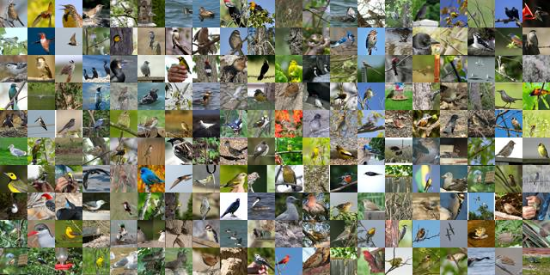
KDES on Fine-Grained Recognition
Bird 200
200 categories
6000 images
Methods | Accuracy
MKL[1] | 19.0
RF[2] | 19.2
HMP[3] | 22.4
KDES | 26.4
[1] S. Branson et al., ECCV 10
[2] B. Yao, A. Khosla, and L. Fei-Fei, CVPR 11
[3] L. Bo, X. Ren, D. Fox, NIPS 11
21
[Bo, Ren, Fox; unpublished]

Slide 22
KDES on Scene Classification
MIT Scene-67
67 indoor scenes
15620 images
Methods | Accuracy | Methods | Accuracy
SP[1] | 34.4 | DPM+Gist-color+SP[1] | 43.1
DPM[1] | 30.4 | Discrim. Patches[3] | 49.4
RBoW[2] | 37.9 | KDES | 54.6
[1] M. Pandey and S. Lazebnik, ICCV 11
[2] S. Parizi, J. Oberlin, and P. Felzenszwalb, CVPR 12
[3] S. Singh, A. Gupta, and A. Efros, ECCV 12
22
[Bo, Ren, Fox; unpublished]

Slide 23
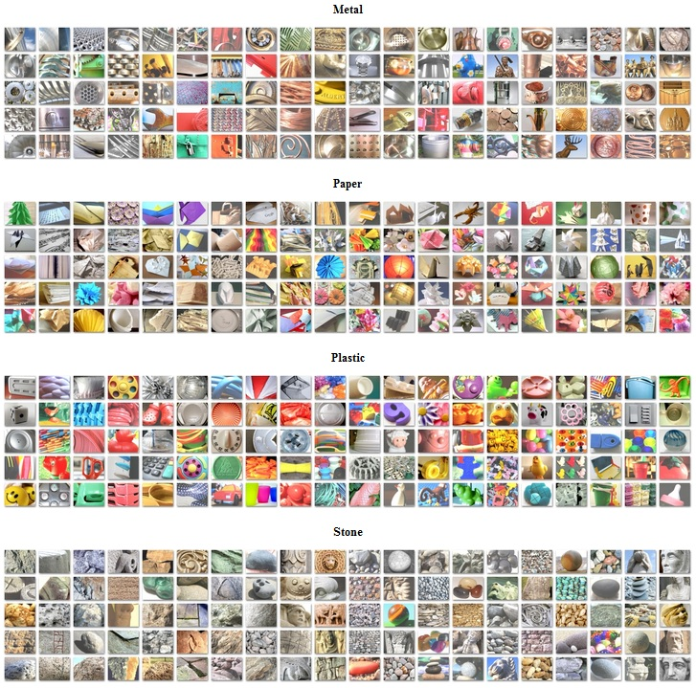
KDES on Material Recognition
MIT Flickr Material Dataset
10 categories, 1,000 images
Two new kernel descriptors
Supervised dimension reduction
Extensive evaluations, new datasets
Methods | Accuracy
aLDA[1] | 45.0
KDES | 54.0
[1] Liu, Sharan, Adelson, Rosenholtz, CVPR 10
23
[Hu, Bo, Ren; BMVC 2011]

Slide 24
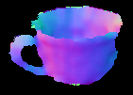
Depth Kernel Descriptors
Gradient
LBP
Surface normal
$$x_{0}$$
Size / Distance
$$d_{i}=\left\|x_{i}−x_{0}\right\|$$
Eigenvalues of Kernel Matrix
$$\left[e_{1},⋯,e_{m}\right]$$
24
[Bo, Ren, Fox; CVPR 2011, IROS 2011]

Slide 25
RGB-D Recognition: Standard Features
303 objects from 51 categories, 250,000 RGB-D views
http://www.cs.washington.edu/rgbd-dataset/
Cluttered scenes
A standard benchmark for RGB-D recognition of everyday objects
[Lai, Bo, Ren, Fox; ICRA 2011]

Slide 26
RGB-D: Kernel Descriptors
303 objects from 51 categories, 250,000 RGB-D views
http://www.cs.washington.edu/rgbd-dataset/
Cluttered scenes
Both RGB-D and depth-only accuracies are vastly improved
[Bo, Ren, Fox; NIP 2010, IROS 2011]

Slide 27
How to Obtain RGB-D Features?
Designed
Learned
SIFT
Deep Network
Kernel Descriptors
Sparse Codes
Faster, more specialized
More generic, adaptive

Slide 28
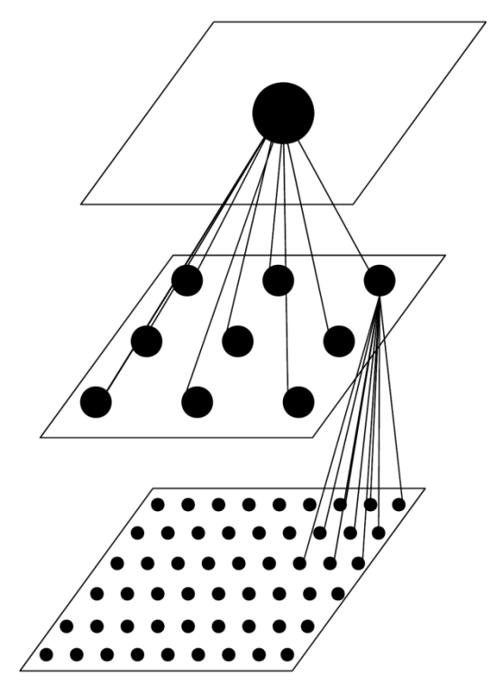
Hierarchical Matching Pursuit
Second
Batch OMP for pooled sparse codes of 16x16 patches
Spatial pooling over the whole image
Contrast Normalization on the whole image
Coding
Learning
K-SVD over pooled sparse codes of 16x16 patches
First
Batch OMP
for each 5x5 raw patch
Spatial pooling
over 16x16 patches
Contrast
Normalization on 16x16 patches
Coding
Learning
K-SVD over 5x5 raw patches
[Bo, Ren, Fox; NIPS 2011]
Notes:
The overall architecture is more important, and we are at an advantage here because we have had a lot of experience working with the kernel descriptors.

Slide 29
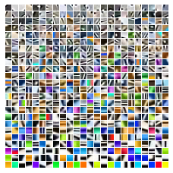
Orthogonal Matching Pursuit (OMP)
Match y to learned dictionary D
Sparse reconstruction
Greedy selection of codewords
≈
4.92×
[Pati et al 1993] [Bo, Ren, Fox; NIPS 2011]

Slide 30
Orthogonal Matching Pursuit (OMP)
Match y to learned dictionary D
Sparse reconstruction
Greedy selection of codewords
≈
4.30×
+0.90×
[Pati et al 1993] [Bo, Ren, Fox; NIPS 2011]

Slide 31
Orthogonal Matching Pursuit (OMP)
Match y to learned dictionary D
Sparse reconstruction
Greedy selection of codewords
≈
4.39×
+0.80×
-0.59×
[Pati et al 1993] [Bo, Ren, Fox; NIPS 2011]

Slide 32
Orthogonal Matching Pursuit (OMP)
Match y to learned dictionary D
Sparse reconstruction
Greedy selection of codewords
≈
4.44×
+0.81×
-0.61×
+0.38×
[Pati et al 1993] [Bo, Ren, Fox; NIPS 2011]
Notes:
20 min

Slide 33
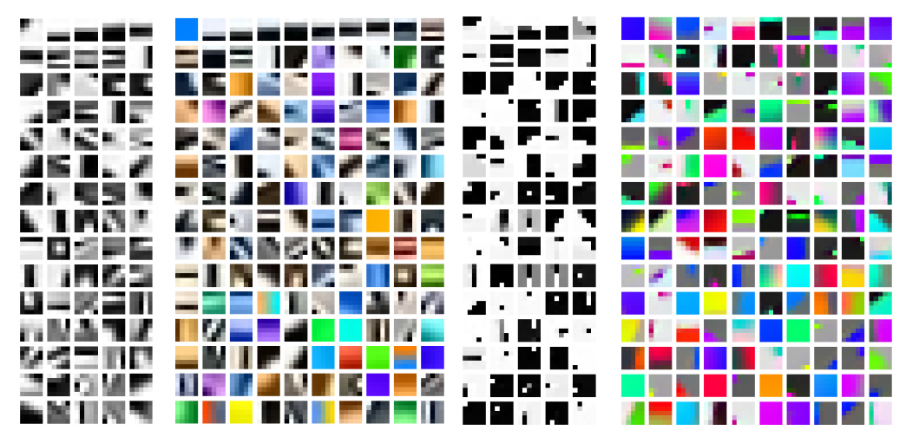
Learned K-SVD Dictionaries
Grayscale RGB Depth 3D surface normal
[Aharon et al 2006] [Bo, Ren, Fox; NIPS 2011, ISER 2012]

Slide 34
Hierarchical Sparse Coding
Matching Pursuit Coding
Spatial Pooling
Matching Pursuit Coding
Spatial Pooling
Linear SVM
Recognition
Image Patch features Image features
[Bo, Ren, Fox; NIPS 2011]

Slide 35
RGB-D Recognition: Standard Features
303 objects from 51 categories, 250,000 RGB-D views
http://www.cs.washington.edu/rgbd-dataset/
Cluttered scenes
A standard benchmark for RGB-D recognition of everyday objects
[Lai, Bo, Ren, Fox; ICRA 2011]

Slide 36
RGB-D Recognition: Sparse Coding
303 objects from 51 categories, 250,000 RGB-D views
http://www.cs.washington.edu/rgbd-dataset/
Cluttered scenes
Both RGB-D and depth-only accuracies are vastly improved
[Bo, Ren, Fox; NIPS 2011, ISER 2012]
Notes:
25min

Slide 37
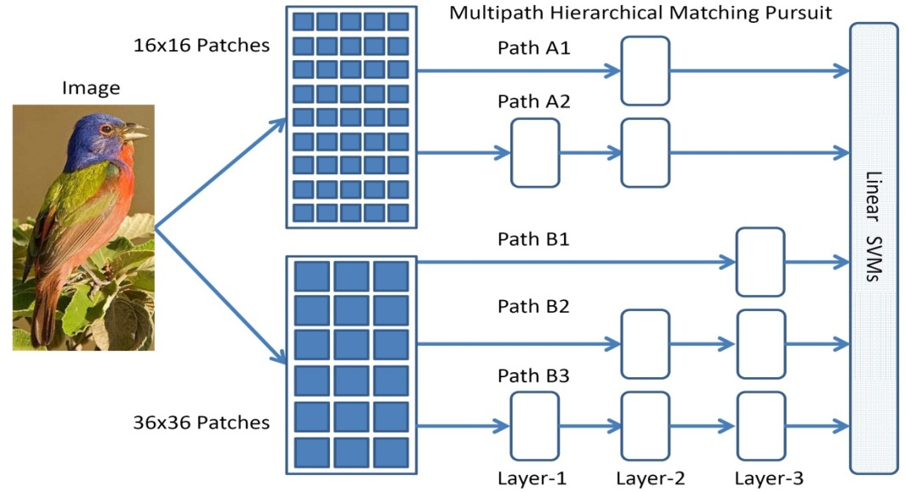
Multipath Hierarchical Matching Pursuit
Intuition: capturing distinctive structures at various scales under various amounts of invariance
#Training Images | 15 | 30 | 45 | 60
Local NBB [1] | 33.5 | 40.1 | - | -
LLC [2] | 34.4 | 41.2 | 45.3 | 47.7
CRBM [3] | 35.1 | 42.1 | 45.7 | 47.9
LASERC [4] | 35.2 | 43.6 | - | -
LP-beta [5] | - | 45.8 | - | -
Our Work | 41.1 | 48.7 | 52.8 | 56.2
Caltech-256:
[1] S. McCann and D. Lowe, CVPR 12
[2] J. Wang et al, CVPR 10
[3] K Sohn et al, ICCV 11
[4] K. Nguyen et al, ECCV 12
[5] P. Gehler and S. Nowozin, ICCV 09
[Bo, Ren, Fox; CVPR 2013]

Slide 38
Two Families of Local RGB-D Features
Kernel Descriptors
Hierarchical Matching Pursuit
Pixel “attributes”:
gradient, color, normal
Collections of Patches
Patch-2-Patch Similarity
Unsupervised Codebook Learning
KPCA Approximation
Efficient Sparse Coding (Greedy)
Single-Patch Descriptor
Spatial Pooling & Hierarchical Coding
[NIPS10; CVPR11; IROS11]
[NIPS11; ISER12; CVPR13; ICRA14]

Slide 39
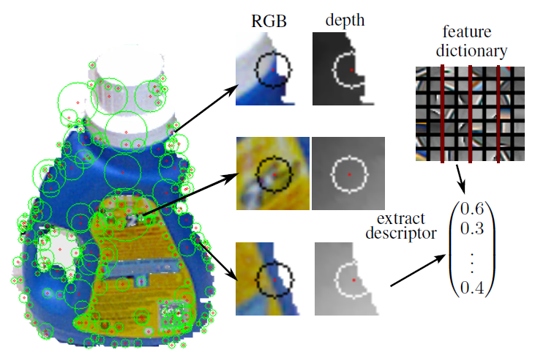
Related Works on RGB-D Recognition
A Learned Feature Descriptor for Object Recognition in RGB-D Data
M. Blum, J. T. Springenberg, J. Wülfing and M. Riedmiller. ICRA 2012
Sparse locations
Convolutional k-means
Category: 86.4%
Instance: 90.4%
HMP 87.5%
HMP 92.8%

Slide 40
Related Works on RGB-D Recognition
Convolutional-Recursive Deep Learning for 3D Object Classification,
R. Socher, B. Huval, B. Bhat, C. Manning and A. Ng; NIPS 2012
Combine CNN and RNN
Fast
Category: 86.8% HMP 87.5%

Slide 41
RGB-D Recognition for Interaction
http://www.youtube.com/watch?v=72xvytAg_UM
[Ryder et al 2011; Lai et al 2011] [Intel CES Demo 2011]

Slide 42
Fine-Grained Activity Recognition
http://homes.cs.washington.edu/~xren/research/ubicomp2012/ubicomp2012_supp.wmv
[Lei, Ren, Fox; Ubicomp 2012]

Slide 43
Outline of Presentation
Introduction
RGB-D Features for Object Recognition
Benchmark and Baseline
Kernel Descriptors: Generalizing SIFT
Hierarchical Matching Pursuit: Unsupervised Feature Learning
Related Works and Applications
Toward Understanding Real-World Scenes
Hierarchical Matching Pursuit and Object Detection
RGB-D Boundary Detection
RGB-D Features for Scene Labeling

Slide 44
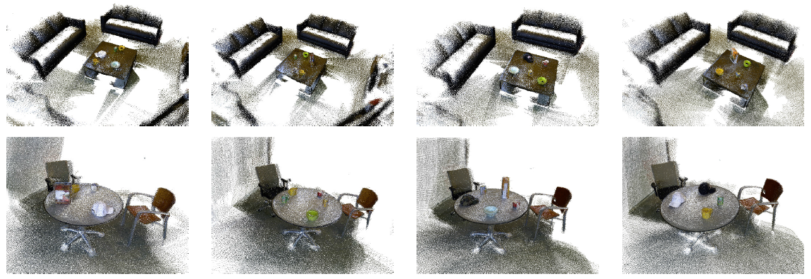
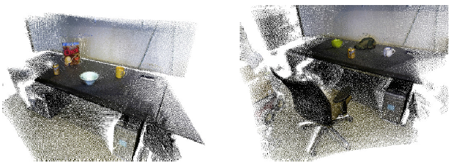
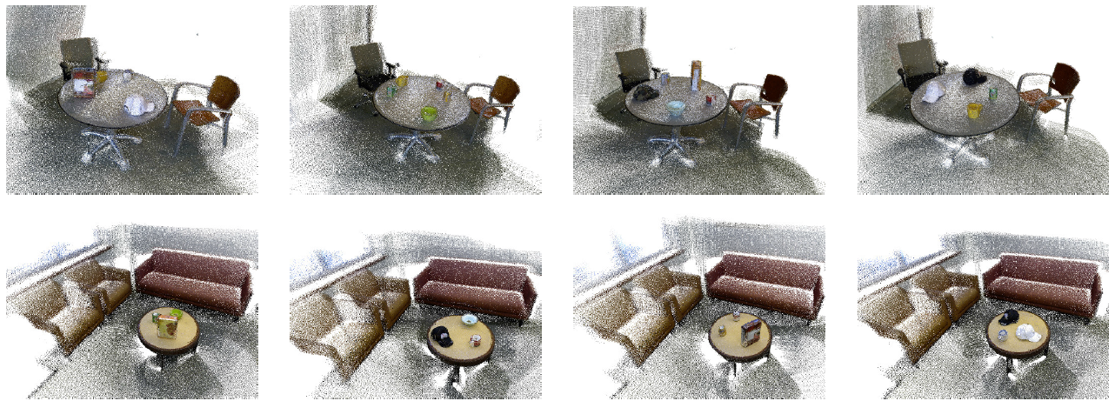
RGB-D Scenes Dataset v.2
14 videos of CSE building: RSE lounge, breakout area, coffee room, office
Tabletop objects: Bowl, cap, cereal box, coffee mug, soda can
Furniture: Coffee table, chair, sofa, table
Available at: http://rgbd-dataset.cs.washington.edu/
[Lai, Bo, Fox; ICRA 2014]

Slide 45
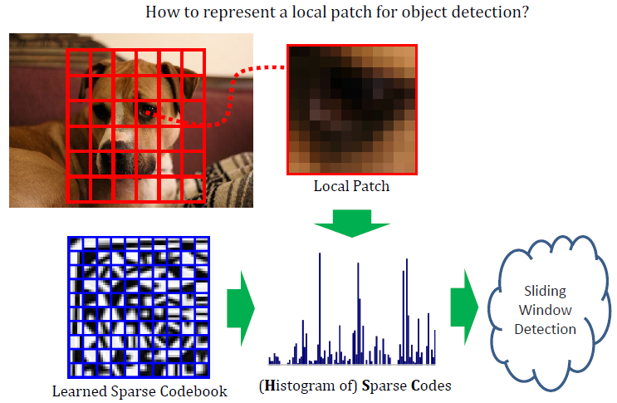
Histogram of Sparse Codes (HSC)
Richer representation
Replaces HOG with learned codes
Everything else kept the same
[Ren, Ramanan; CVPR 2013]

Slide 46
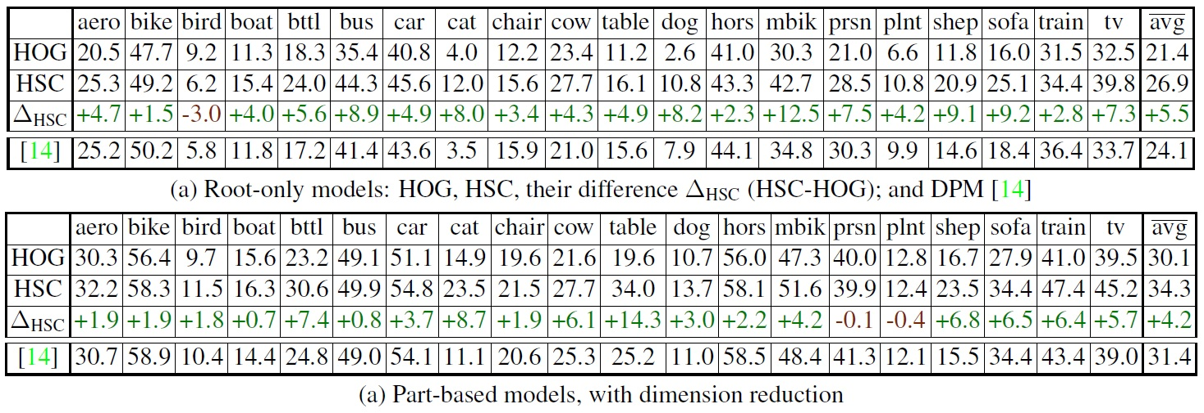
Histogram of Sparse Codes (HSC)
Consistent improvement across all categories, root only and part-based
First learning approach that does significantly than HOG
[Ren, Ramanan; CVPR 2013]

Slide 47
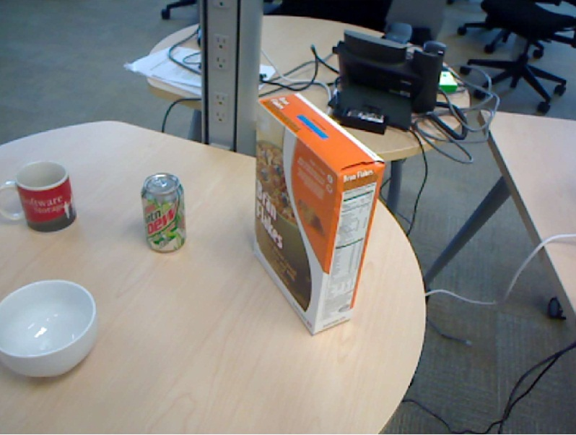
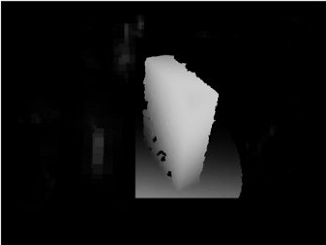
Histogram of Sparse Codes for RGB-D Detection
Use learned color and depth dictionaries
No change to the algorithm pipeline
[Ren, Ramanan; CVPR 2013]
Notes:
HSC is learned from image data, and has been shown to outperform HOG

Slide 48
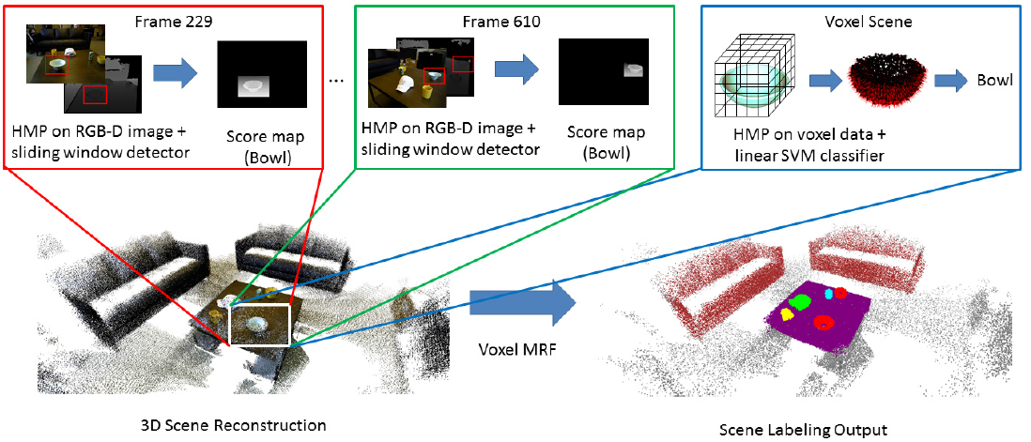
RGB-D Object Detection in Video
Input is not a single RGB-D frame, but a continuous video
RGB-D frames are spatially registered ➔ merged 3D representation
[Lai, Bo, Fox; ICRA 2014]

Slide 49
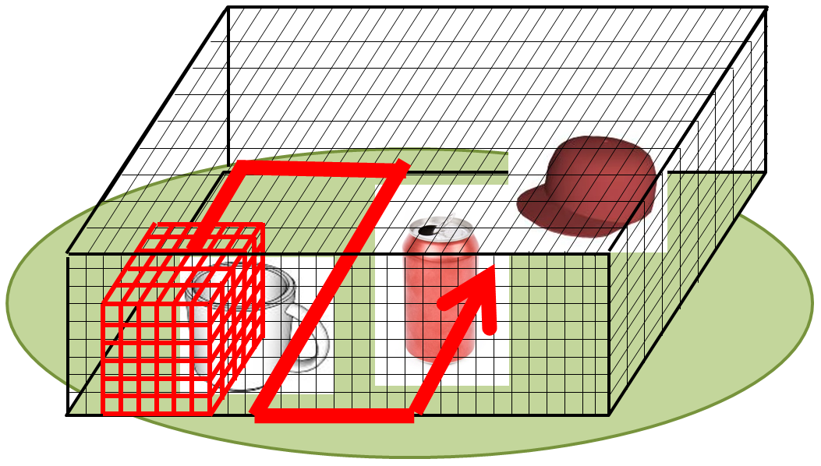
3D Voxel-based Classification
Conceptually, slide 3D box across voxel space
In practice, we rely on segmentation (future work needed here ☺ )
[Lai, Bo, Fox; ICRA 2014]
Notes:
Sliding cube at true size, no need to search across scales
Still too expensive, use segmentation to eliminate most candidate windows

Slide 50
RGB-D Object Detection
http://www.youtube.com/watch?v=nmvvvlSDJjg
[Lai, Bo, Fox; ICRA 2014]

Slide 51
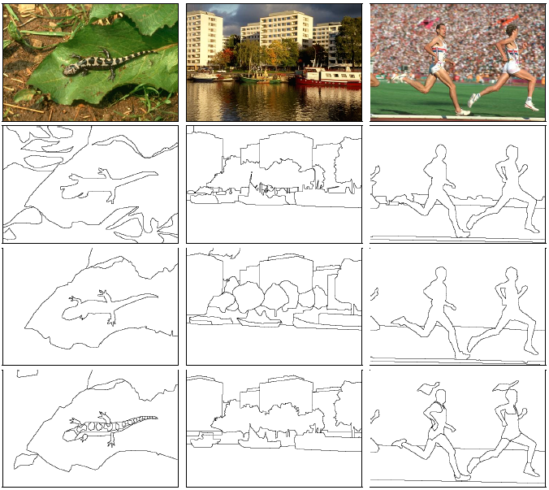
Contour Detection
The Berkeley Benchmarks
natural images
variety of generic scenes
high-quality groundtruth
multiple human subjects
The Basis of …
region segmentation
shape analysis
object recognition
scene understanding
video segmentation
… …
51
[Martin, Fowlkes, Tal, Malik; ICCV 2001]

Slide 52
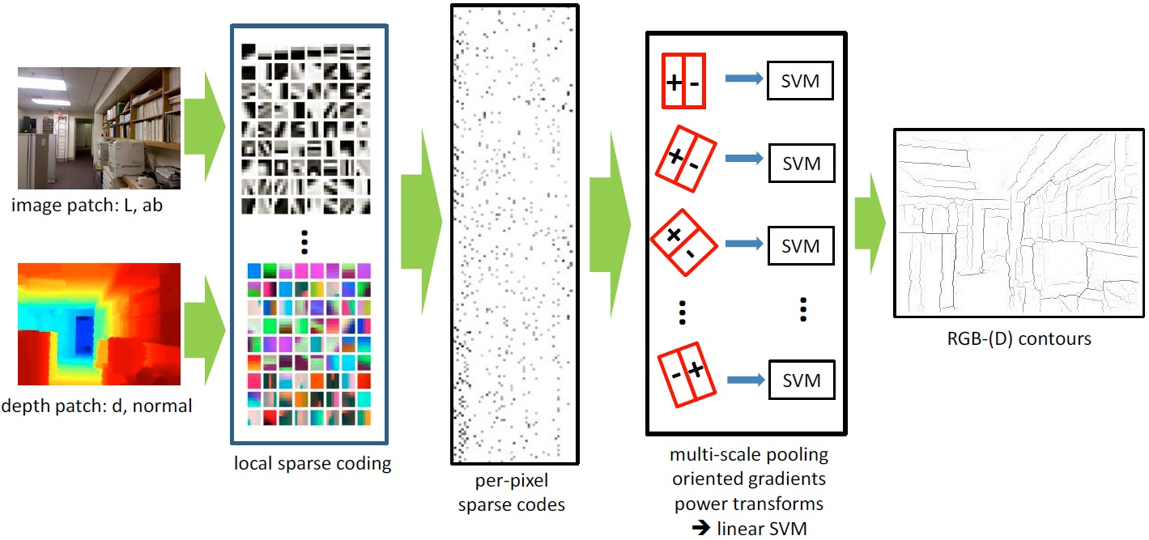
Sparse Code Gradients
Learning
Design
[Ren, Bo; NIPS 2012]
Notes:
Balance of design and learning

Slide 53
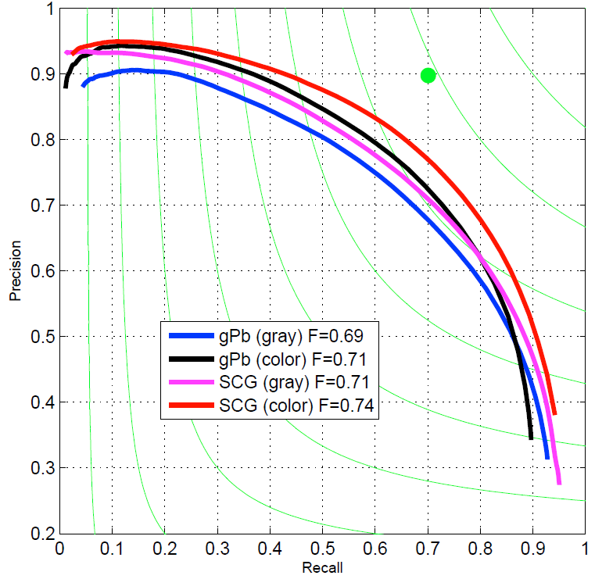
Precision/Recall on BSDS500
Higher precision
Higher recall
1/3 of the gap to
human-level accuracy
~1.5 cost comparing to gPb (integral images)
[Ren, Bo; NIPS 2012]

Slide 54
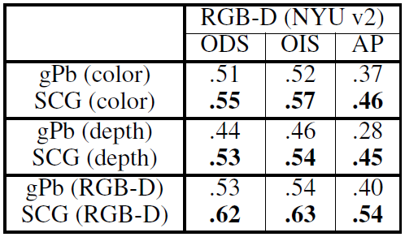
RGB-D Contour Detection
Exactly the same training/test algorithms take RGB-D input.
1449 Kinect frames (on 240x320)
a large variety of scenes
[Ren, Bo; NIPS 2012]

Slide 55
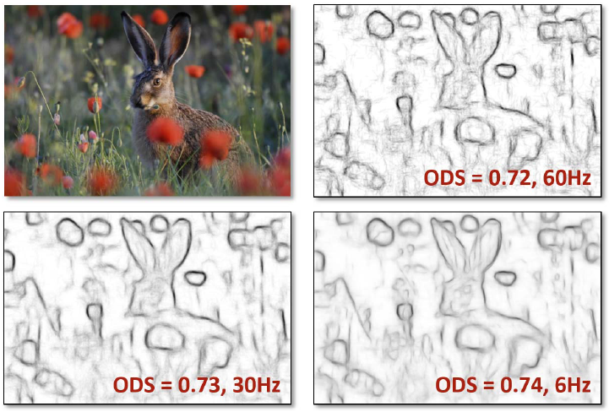
Structured Forests for Fast Edge Detection
Predicting patches instead of pixels
Structured random forest
[Dollar, Zitnick; ICCV 2013]

Slide 56
RGB-D Scene Labeling
NYU Kinect Dataset: 2284 frames, indoor (7 scene types)
640x480 Color+Depth, 13 semantic classes
[Silberman and Fergus, 3DRR 2011]

Slide 57
RGB-(D) Scene Labeling Benchmarks
NYU Kinect Dataset
2284 frames, indoor (7 types)
640x480 Color+Depth
13 semantic classes
SIFT+MRF [3dRR11] | 56.6±2.9%
KDES Superpixel (RGB) | 66.2±0.3%
KDES Superpixel (Depth) | 63.4±0.6%
KDES Superpixel (RGB-D) | 71.4±0.6%
KDES + Segmentation Tree | 76.1±0.9%
[Ren, Bo, Fox, CVPR 2012]

Slide 58
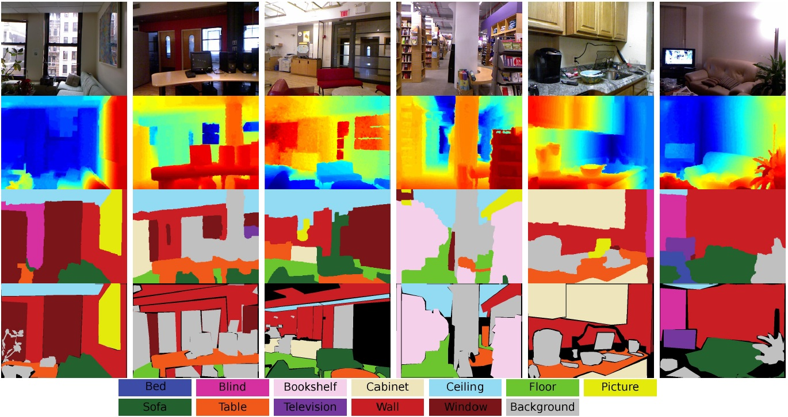
Semantic Scene Labeling (RGB-D)
[Ren, Bo, Fox, CVPR 2012]

Slide 59
RGB-(D) Scene Labeling Benchmarks
NYU Kinect Dataset
2284 frames, indoor (7 types)
640x480 Color+Depth
13 semantic classes
SIFT+MRF [3dRR11] | 56.6±2.9%
KDES Superpixel (RGB) | 66.2±0.3%
KDES Superpixel (Depth) | 63.4±0.6%
KDES Superpixel (RGB-D) | 71.4±0.6%
KDES + Segmentation Tree | 76.1±0.9%
 | Pixelwise | Average
Region-based Energy [ICCV09] | 76.4±1.2% | 65.5%
Selecting Regions [CVPR10] | 79.4±1.4% | -
Stacked Labeling [ECCV10] | 76.9% | 66.2%
Superpixel MRF [ECCV10] | 77.5% | -
Recursive NN [ICML11] | 78.1% | -
Our Work | 82.9±0.9% | 74.5%
Stanford Background Dataset
715 images, outdoor
320x240 Color only
8 semantic classes (3 geometric)
[Ren, Bo, Fox, CVPR 2012]

Slide 60
Summary
RGB-D cameras provide rich, robust semantic information and are well positioned to enable interactive applications.
RGB-D features are the key to recognition, and feature learning approaches adapt well to new sensor modality.
A balance of design and learning has led to two types of features: kernel descriptors, hierarchical matching pursuit.
RGB-D object recognition provides a solid basis for understanding real-world scenes and activities.
Feature learning applies to many vision problems such as object detection, segmentation, and scene labeling.
(datasets and source codes available)
Tutorial @ CVPR 2014

Slide 61
THANK YOU

